Slide 1


Oscar Navarro
16/01/2023

Slide 2

Outline
Executive Summary
Introduction
Methodology
Results
Conclusion
Appendix

Slide 3
Executive Summary
Summary of methodologies
Data collected through SpaceX API and web-scraping
Data prepared and transformed into a useable subset
Model selected trough comparison
Summary of all results
EDA identified the best features to predict successful landings;
Machine Learning model predicted if the Falcon 9 first stage will land successfully (0.833).

Slide 4
Introduction
Project background and context
SpaceX is the most successful company of the commercial space age, making space travel affordable. The company advertises Falcon 9 rocket launches on its website, with a cost of 62 million dollars; other providers cost upward of 165 million dollars each, much of the savings is because SpaceX can reuse the first stage. Therefore, if we can determine if the first stage will land, we can determine the cost of a launch. Based on public information and machine learning models, we are going to predict if SpaceX will reuse the first stage.
Problems you want to find answers
We need a model able to predict the success of a landing to calculate the cost of a launch.
We also need to identify the best site launch.

Slide 5

Section 1

Slide 6
Methodology
Executive Summary
Data collection methodology:
Using SpaceX Rest API Using Web Scrapping from Wikipedia
Perform data wrangling
Filtering the data Dealing with missing values Using One Hot Encoding to prepare the data to a binary classification
Perform exploratory data analysis (EDA) using visualization and SQL
Perform interactive visual analytics using Folium and Plotly Dash
Perform predictive analysis using classification models
Tuning and evaluation of classification models to ensure the best results

Slide 7
Data Collection
We collected data sets from SpaceX API and using web scraping techniques, the Falcon9 Wikipedia page information.

Slide 8
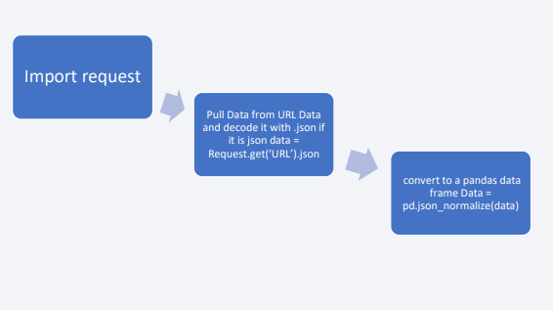
Data Collection – SpaceX API
Data collection with SpaceX REST calls
Add the GitHub URL of the completed SpaceX API calls notebook (must include completed code cell and outcome cell), as an external reference and peer-review purpose

Slide 9
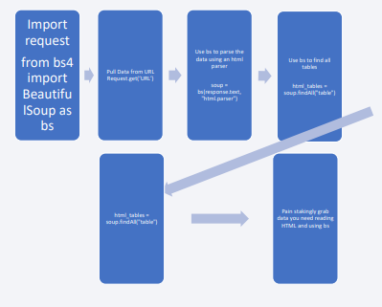
Data Collection - Scraping
Web scraping process
During this process we scrapped Falcon 9 launch records with BeautifulSoup:
Extracting a Falcon 9 launch records HTML table from Wikipedia
Parsing the table and convert it into a Pandas data frame
Add the GitHub URL of the completed web scraping notebook, as an external reference and peer-review purpose

Slide 10
Data Wrangling
We performed some Exploratory Data Analysis (EDA) to find patterns in the data and determine what would be the label for training supervised models.
The main contribution was converting landing outcomes into training labels with ‘1’ meaning the booster successfully landed and ‘0’ representing the landing was unsuccessful.
Add the GitHub URL of your completed data wrangling related notebooks, as an external reference and peer-review purpose

Slide 11
EDA with Data Visualization
We rendered scatter plots and bar plots to visualize the relationship between pair of features:
Payload Mass vs Flight Number
Launch Site vs Flight Number
Launch Site vs Payload Mass
Orbit vs Flight Number
Payload vs Orbit

Slide 12
EDA with SQL
We used SQL queries to:
Display the names of the unique launch sites in the space mission
Display 5 records where launch sites begin with the string 'CCA’
Display the total payload mass carried by boosters launched by NASA (CRS)
Display average payload mass carried by booster version F9 v1.1
List the date when the first successful landing outcome in ground pad was achieved.
List the names of the boosters which have success in drone ship and have payload mass greater than 4000 but less than 6000
List the total number of successful and failure mission outcomes
List the names of the booster versions which have carried the maximum payload mass.

Slide 13
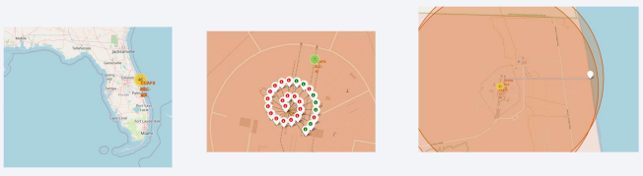
Build an Interactive Map with Folium
We used markers, circles, lines and marker clusters on Folium Maps to highlight:
The location of launch sites
Points of interest, such as the like NASA Johnson Space Center
Distance between launch sites and geographical features, like a coastline
Cluster of events with close coordinates
Add the GitHub URL of your completed interactive map with Folium map, as an external reference and peer-review purpose

Slide 14
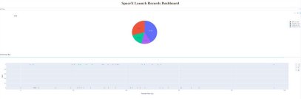
Build a Dashboard with Plotly Dash
Added a drop down list to enable launch site selection
Added a pie chart to show the total successful launches count for all sites
Added a callback function for `site-dropdown` as input, `success-pie-chart` as output
Added a callback function for `site-dropdown` and `payload-slider` as inputs, `successpayload-scatter-chart` as output
Add the GitHub URL of your completed Plotly Dash lab, as an external reference and peer-review purpose

Slide 15
Predictive Analysis (Classification)
Summarize how you built, evaluated, improved, and found the best performing classification model
You need present your model development process using key phrases and flowchart
Add the GitHub URL of your completed predictive analysis lab, as an external reference and peer-review purpose

Slide 16
Results
Exploratory data analysis results
We see that as the flight number increases, the first stage is more
likely to land successfully. The payload mass is also important; it
seems the more massive the payload, the less likely the first
stage will return.
• Predictive analysis result:
Our decision tree model performed the best with 0.8333

Slide 17

Section 2

Slide 18
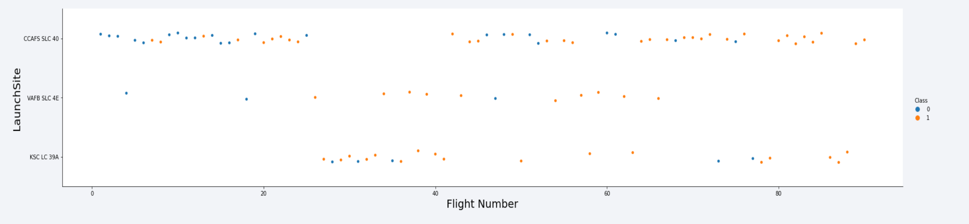
Flight Number vs. Launch Site
According to the plot above, the most successful launch site is CCAF5 SLC 40
In second place VAFB SLC 4E and third place KSC LC 39A;
Also, the overall success rate is improving over time.

Slide 19
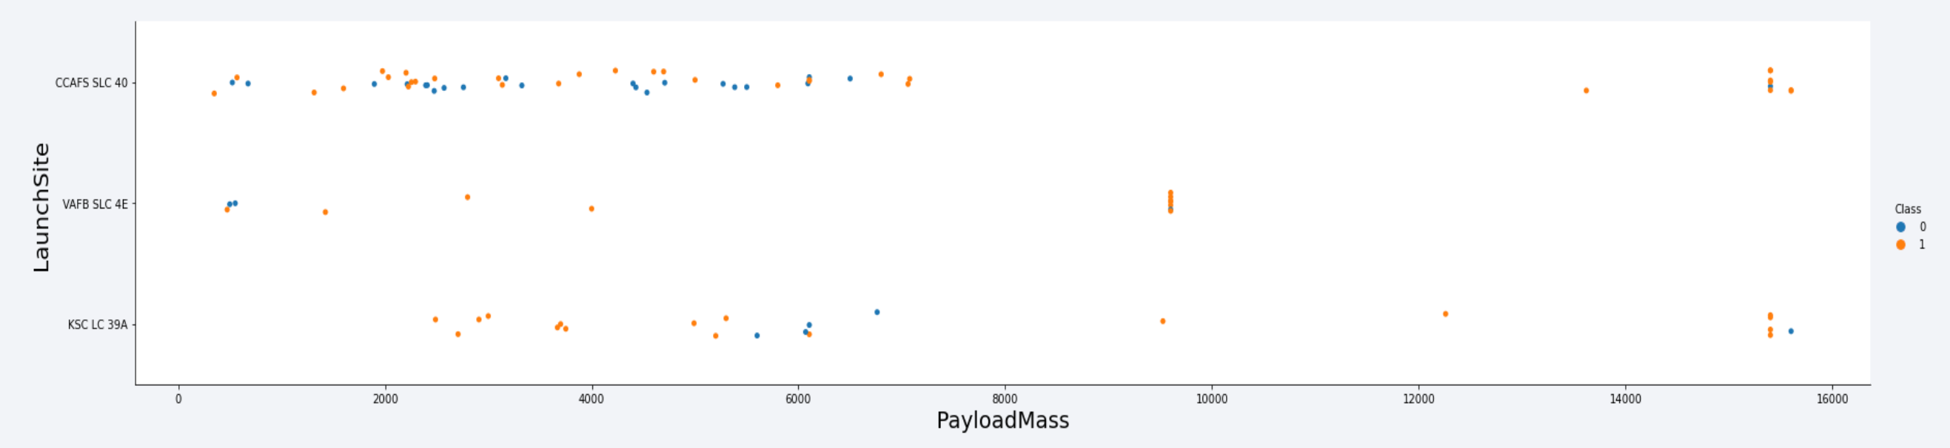
Payload vs. Launch Site
Higher payloads (over 12,000kg) have a better success rate at CCAFS SLC 40 and KSC LC 39A launch sites

Slide 20
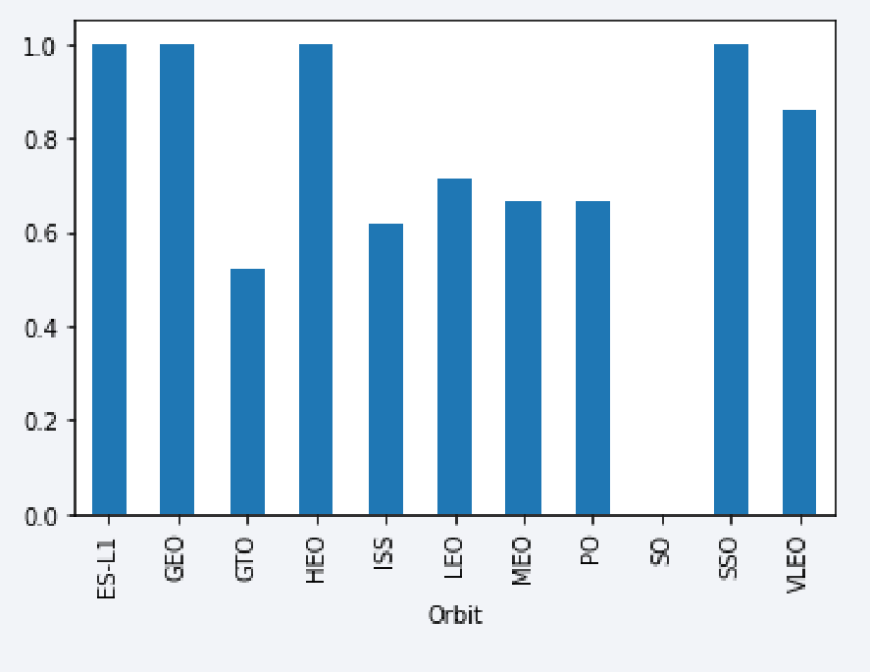
Success Rate vs. Orbit Type
The following orbits have the highest success rates:
ES-L1
GEO
HEO
SSO

Slide 21
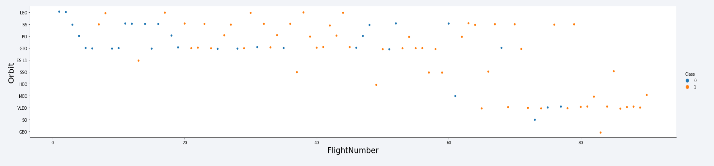
Flight Number vs. Orbit Type

Slide 22
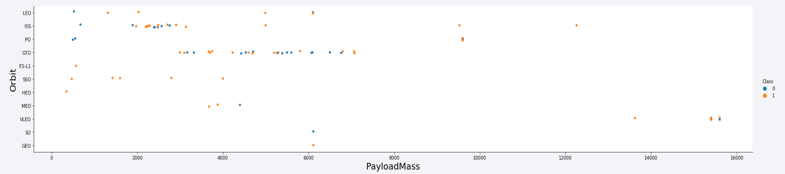
Payload vs. Orbit Type

Slide 23
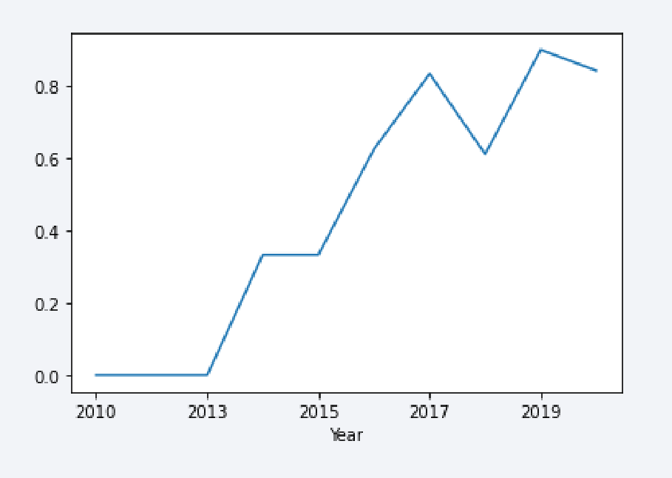
Launch Success Yearly Trend

Slide 24
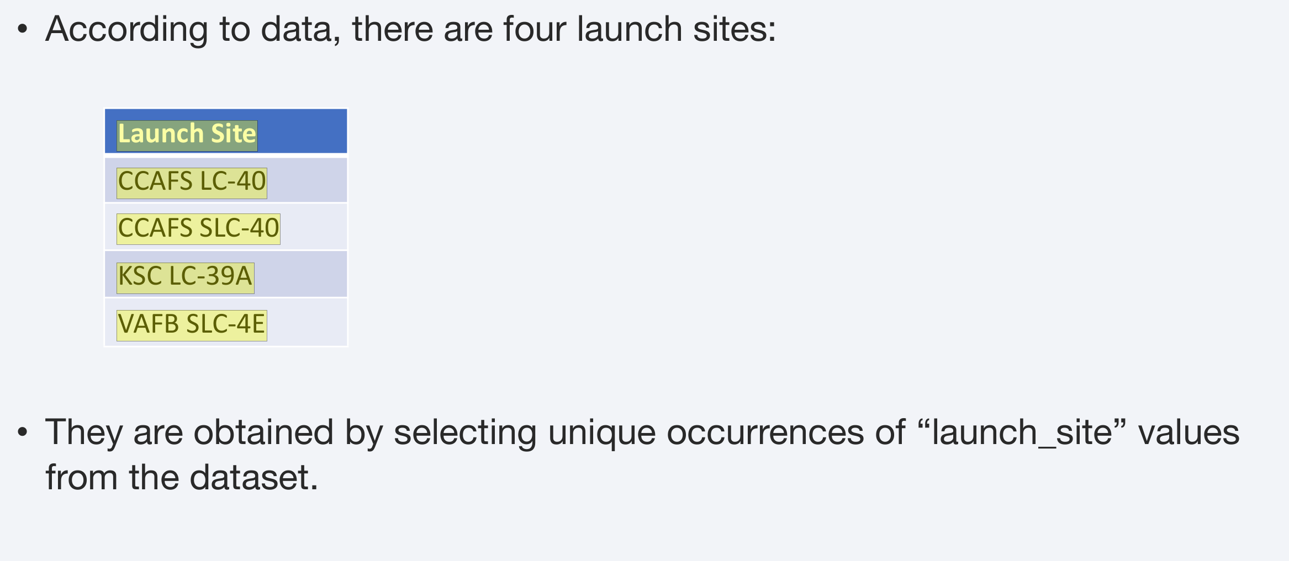
All Launch Site Names
Find the names of the unique launch sites
Present your query result with a short explanation here

Slide 25
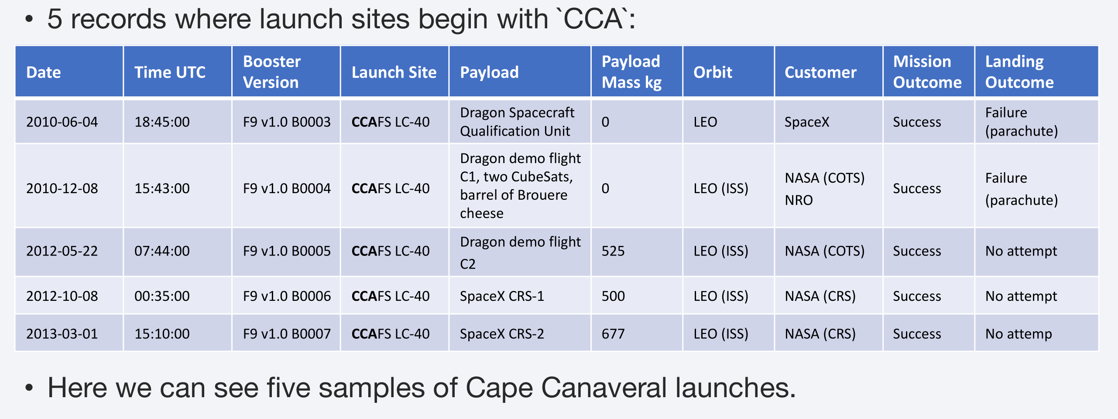
Launch Site Names Begin with 'CCA'
Find 5 records where launch sites begin with `CCA`
Present your query result with a short explanation here

Slide 26
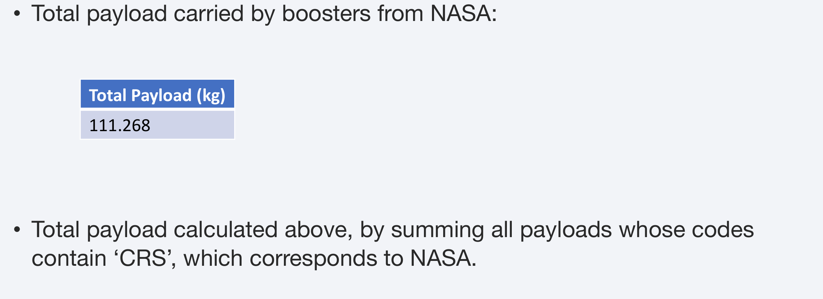
Total Payload Mass
Calculate the total payload carried by boosters from NASA
Present your query result with a short explanation here

Slide 27
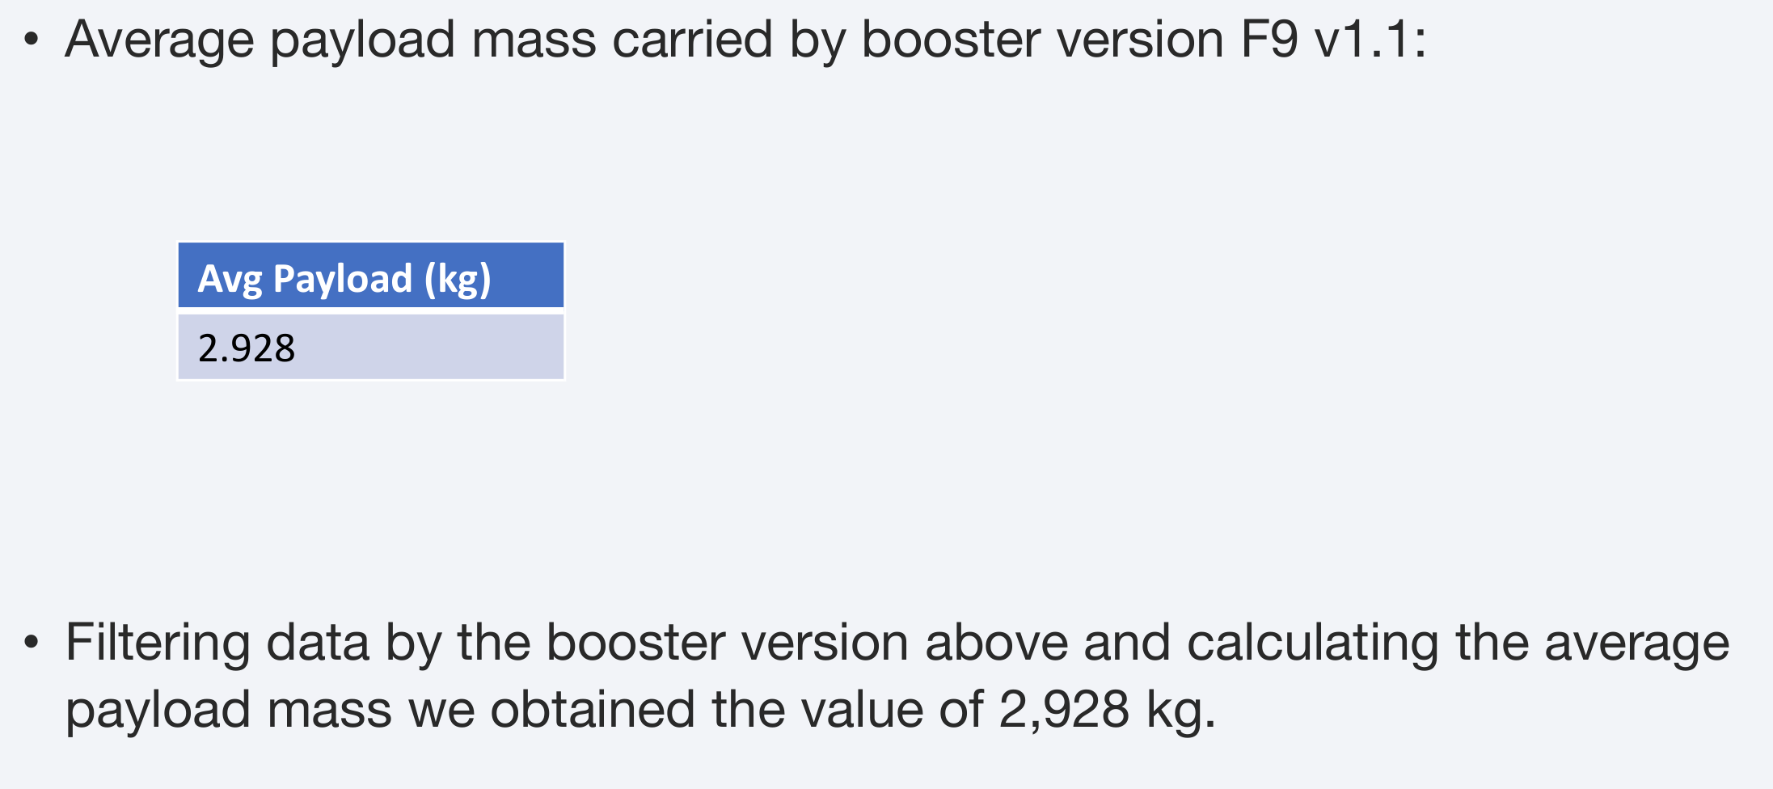
Average Payload Mass by F9 v1.1
Calculate the average payload mass carried by booster version F9 v1.1
Present your query result with a short explanation here

Slide 28
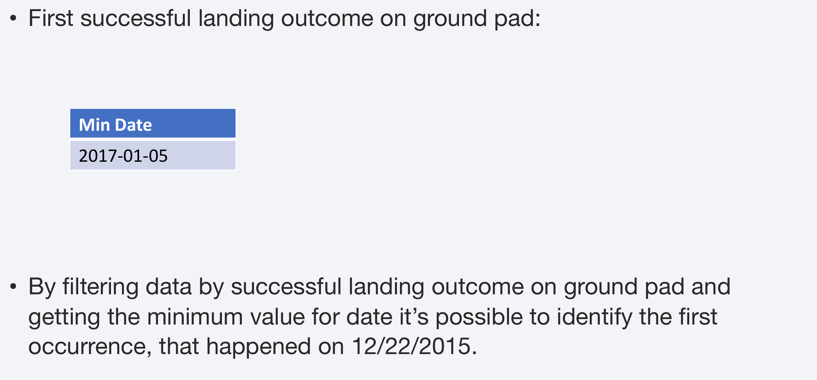
First Successful Ground Landing Date
Find the dates of the first successful landing outcome on ground pad
Present your query result with a short explanation here

Slide 29
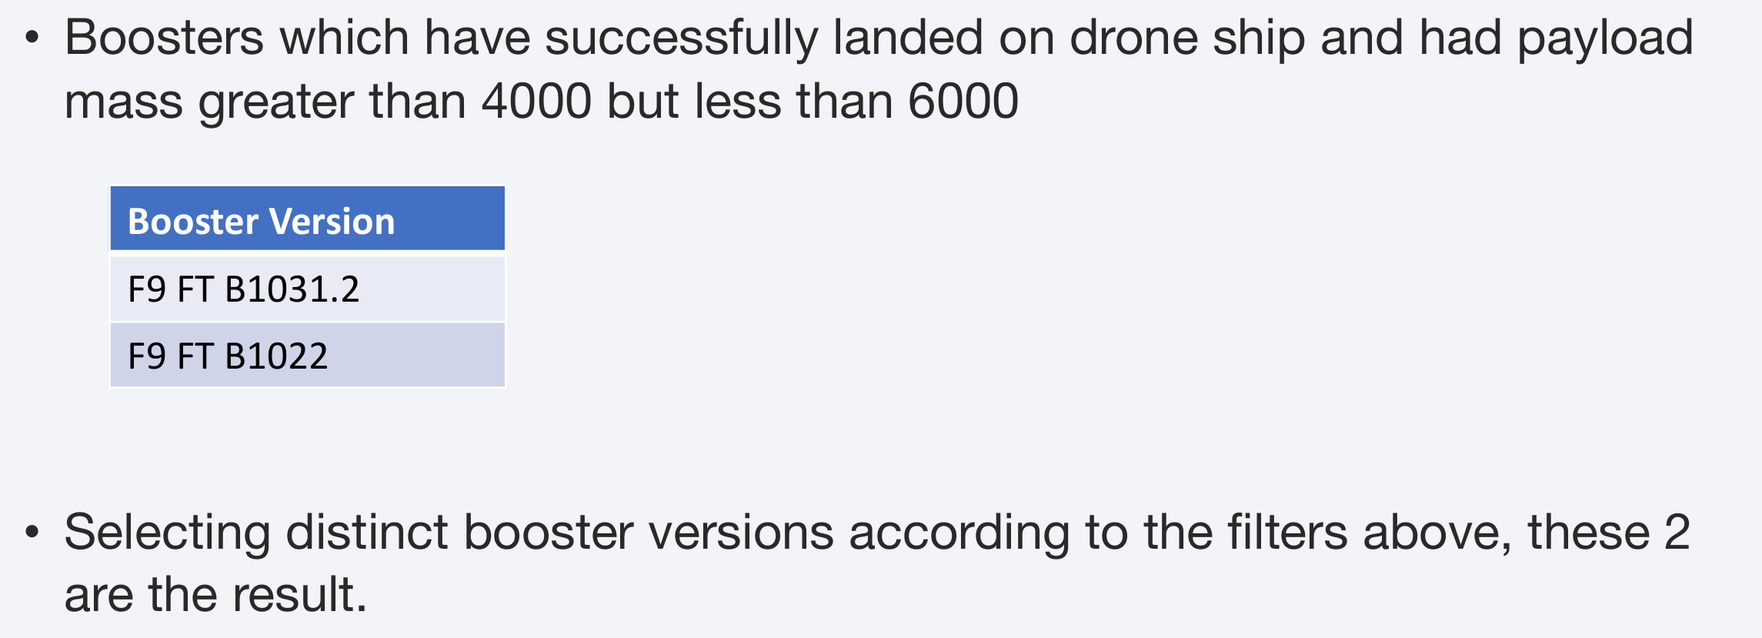
Successful Drone Ship Landing with Payload between 4000 and 6000
List the names of boosters which have successfully landed on drone ship and had payload mass greater than 4000 but less than 6000
Present your query result with a short explanation here

Slide 30
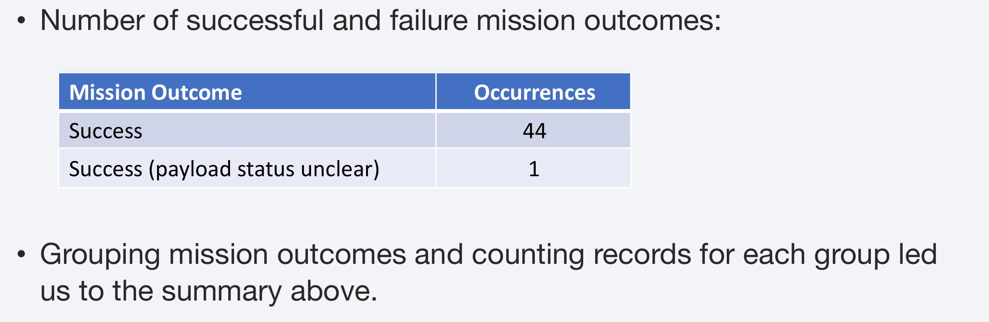
Total Number of Successful and Failure Mission Outcomes
Calculate the total number of successful and failure mission outcomes
Present your query result with a short explanation here

Slide 31
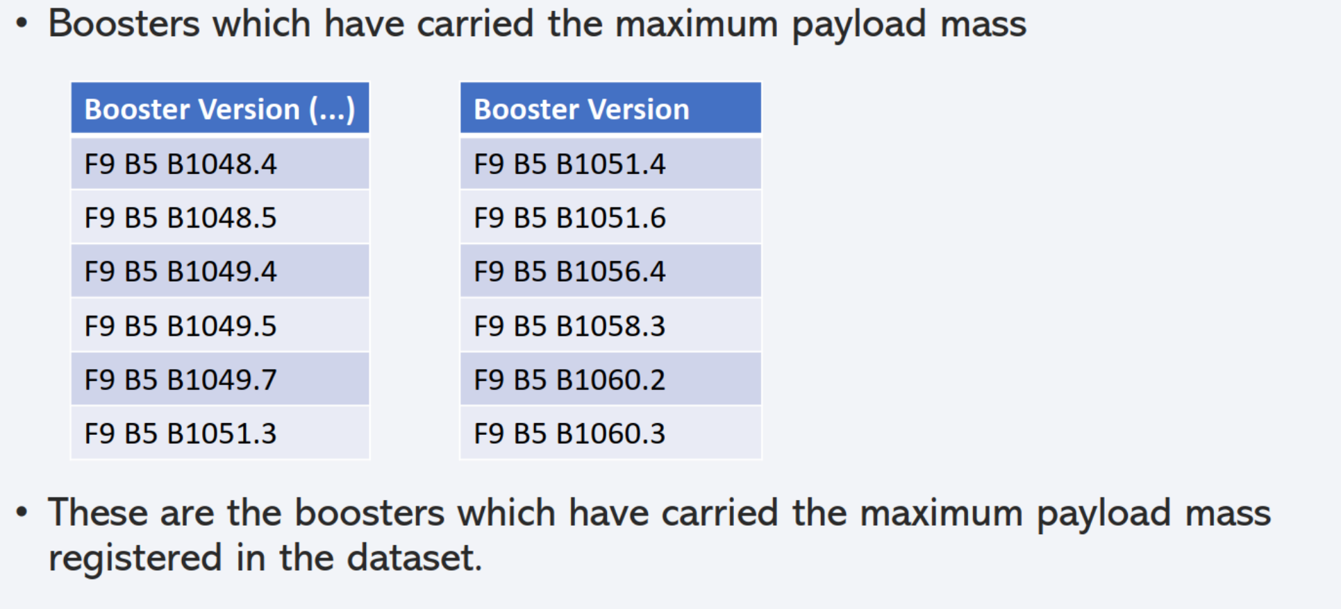
Boosters Carried Maximum Payload

Slide 32
2015 Launch Records
List the failed landing_outcomes in drone ship, their booster versions, and launch site names for in year 2015
Booster Version | Launch Site
F9 v1.1 B1012 | CCAFS LC-40

Slide 33
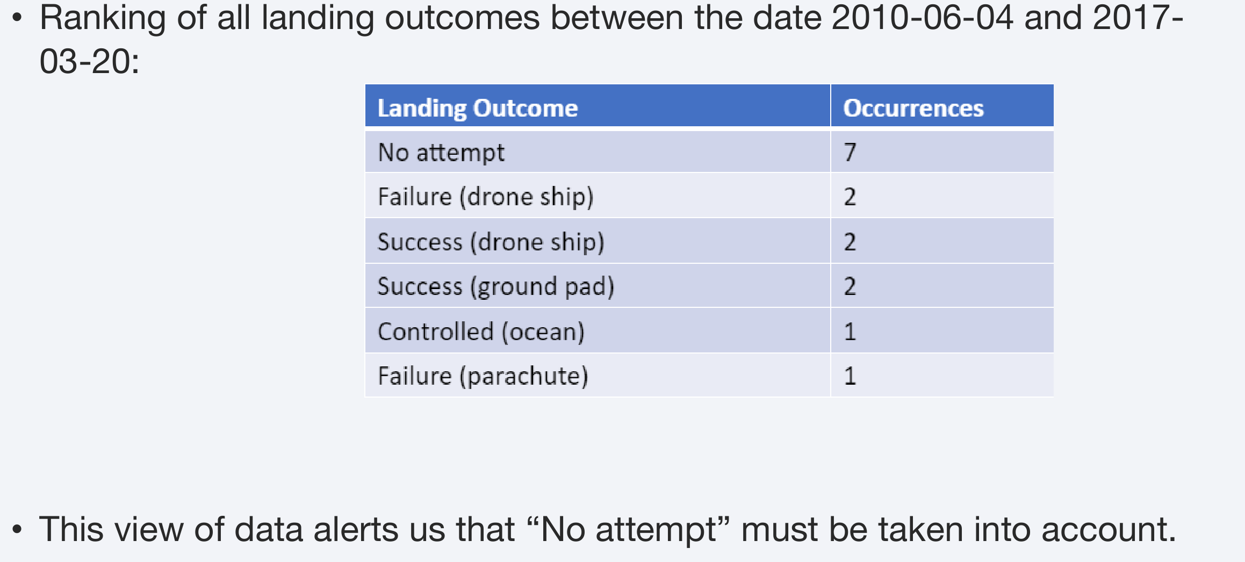
Rank Landing Outcomes Between 2010-06-04 and 2017-03-20
Rank the count of landing outcomes (such as Failure (drone ship) or Success (ground pad)) between the date 2010-06-04 and 2017-03-20, in descending order
Present your query result with a short explanation here

Slide 34

Section 3

Slide 35
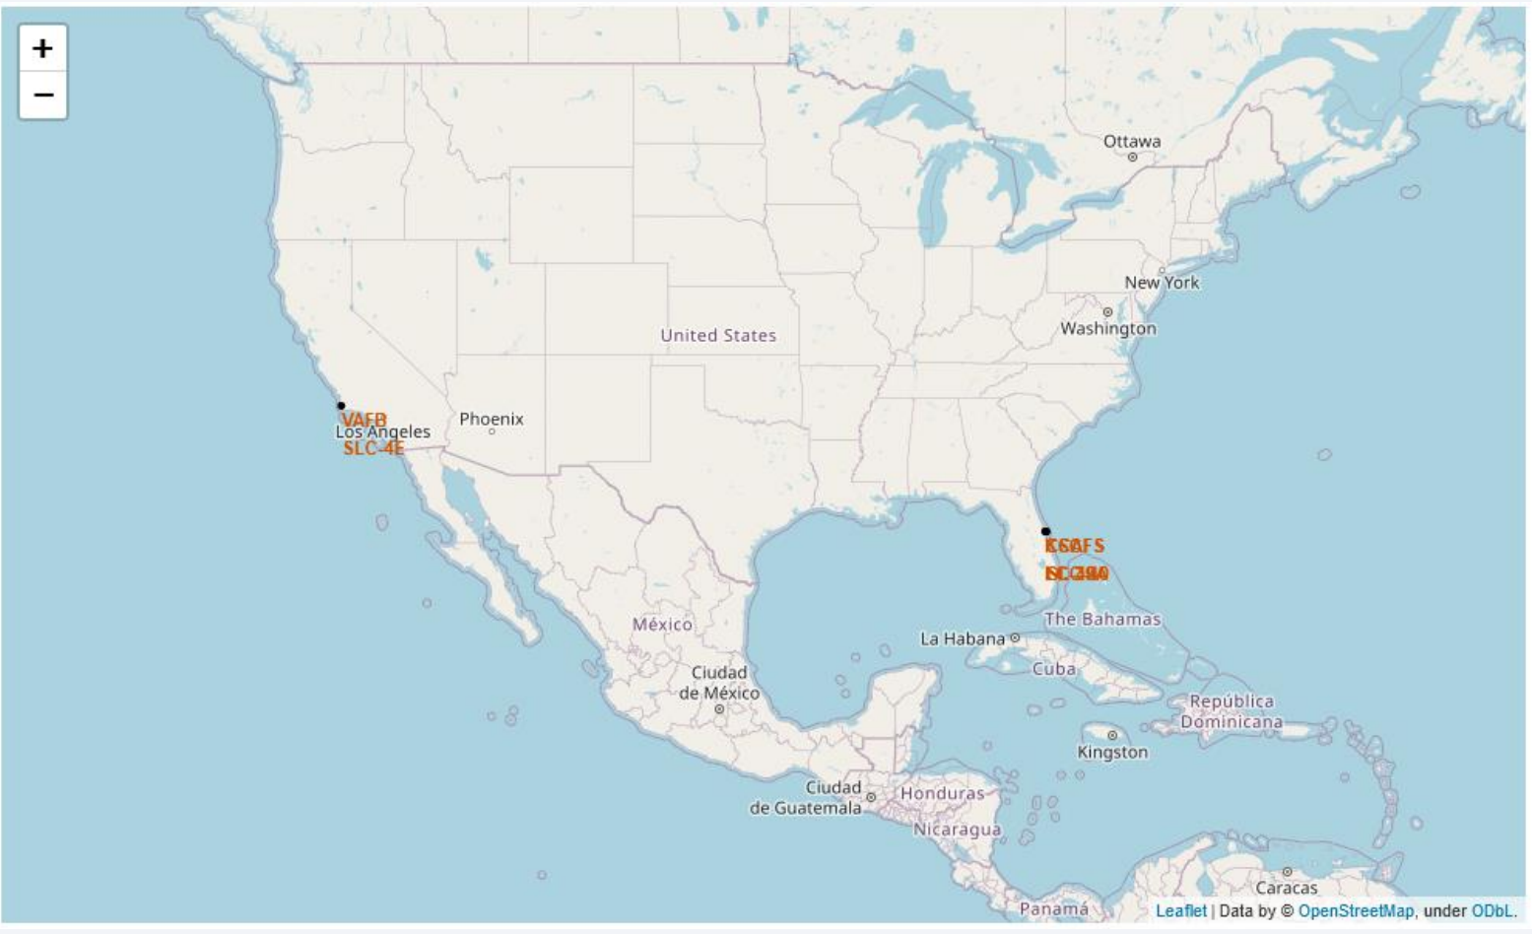
All launch sites

Slide 36
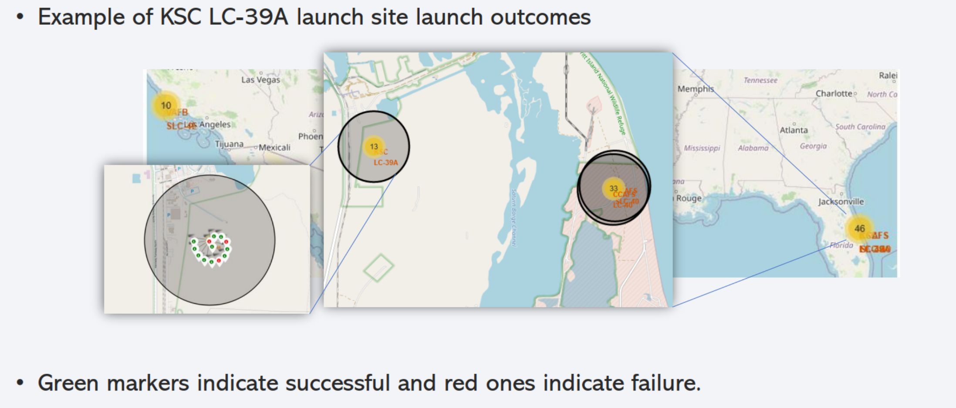
Launch outcome by launch site

Slide 37

Section 4

Slide 38
Section 3

Slide 39
Section 4

Slide 40
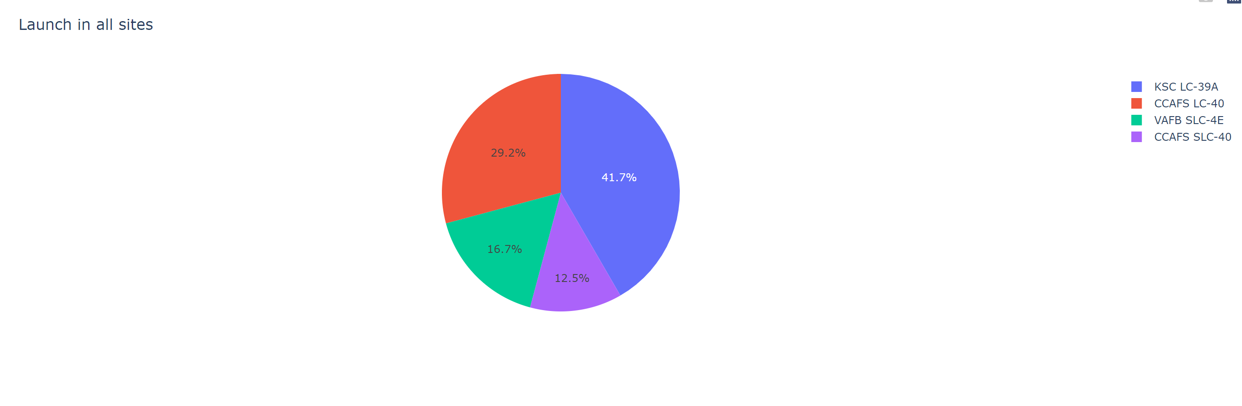
Successful Launches by Site

Slide 41
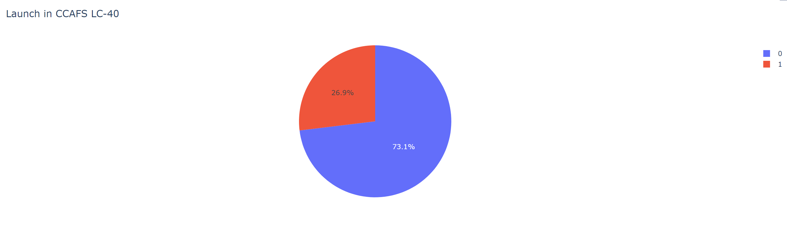
Launch Success Ratio for KSC LC-39A

Slide 42
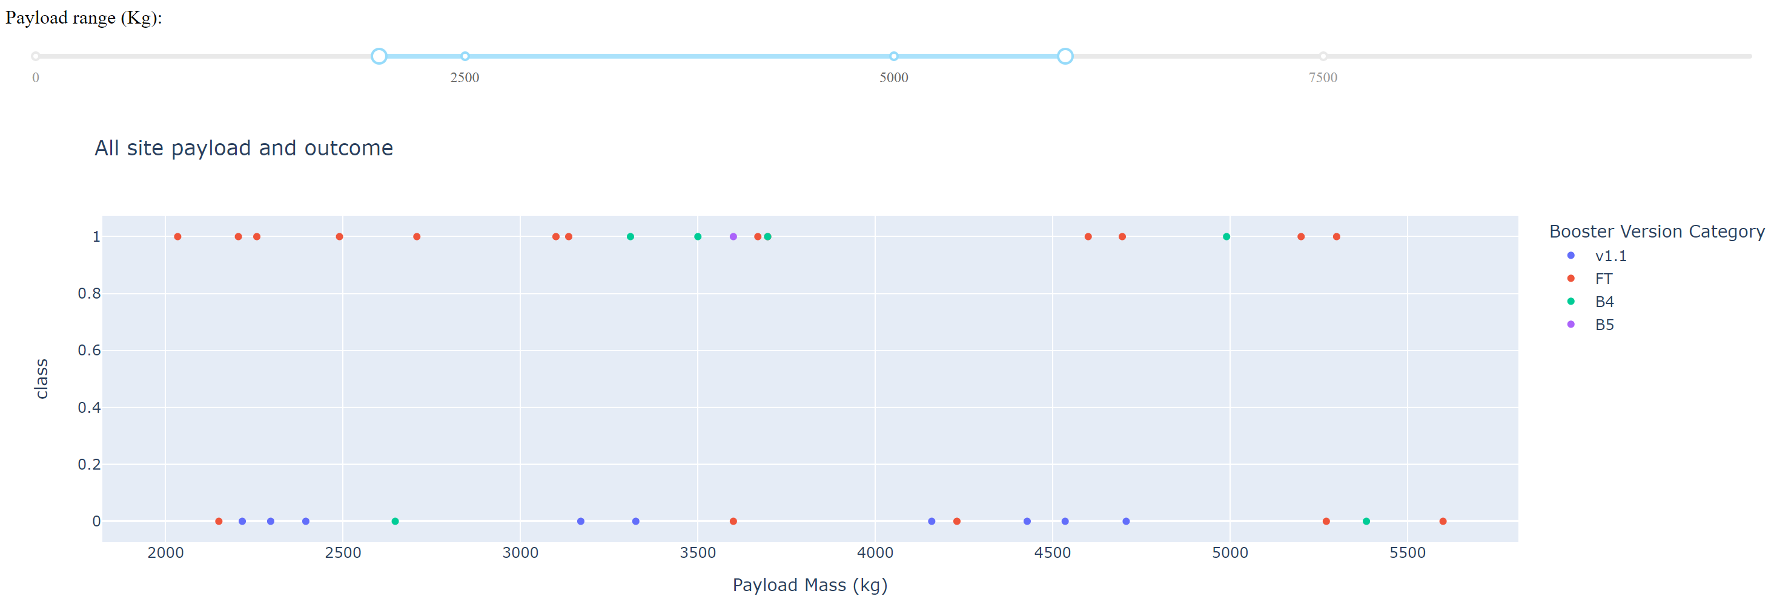
Payload vs Launch Outcome

Slide 43

Section 5

Slide 44
Section 5

Slide 45
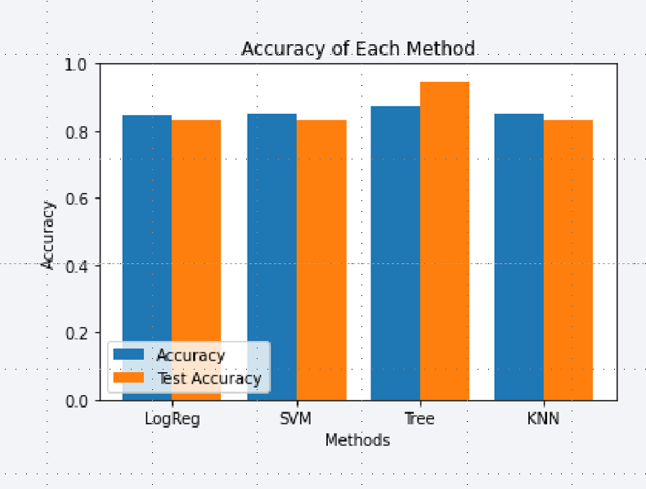
Classification Accuracy
Four classification models were tested, and their accuracies are plotted beside
The classifier model with the highest accuracy is the Decision Tree

Slide 46
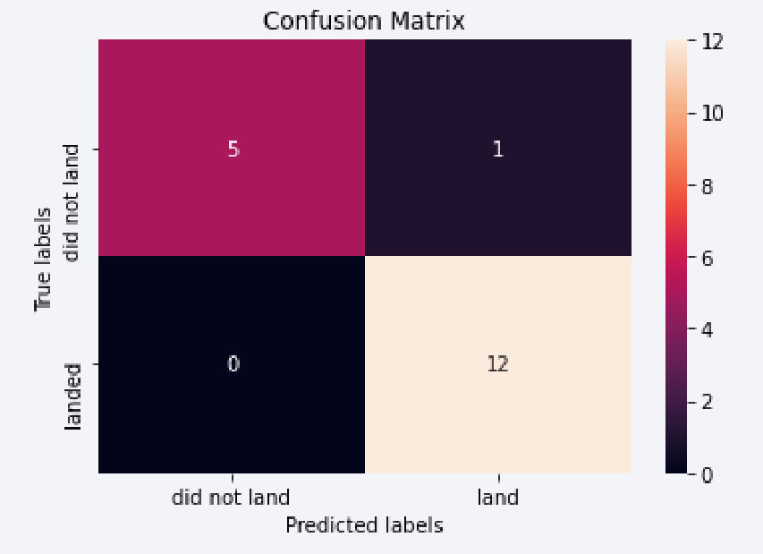
Confusion Matrix
The Decision Tree confusion matrix shows the largest number of true positive and true negative compared to other models.

Slide 47
Conclusions
KSC LC-39A is the launch site with the highest success rate
Higher payload launches are more successful
Decision Tree Classifier can be used to predict successful landings and increase profits.

Slide 48
Appendix
SpaceX API https://api.spacexdata.com

Slide 49


